Slide 1
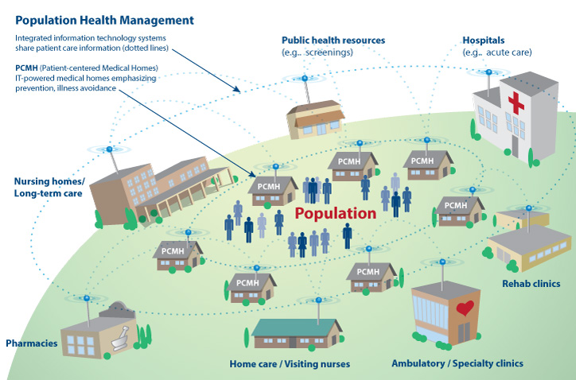
Population Health Management
Dr. Prasanna Krishnasamy,
Medical Director, Medical Homes
Merrin Permut,
Executive Director, Clinical Integration
Jackie Ross,
Manager, Health Home Support

